Slide 1
Coach Notes
This lesson is a bit lengthy and will be difficult if the students are not properly prepared.
Stress to the students before class that they should begin building part of the circuit and to take their time.
This circuit will be difficult to build in a hurry and is prone to error so it would be best for them to build most of it before class.
There is a written description of the circuit which may be easier for the students to use.

Slide 2
Machine Learning with Raspberry Pi
4-Digit 7-Segment Display
AI Code Academy

Slide 3
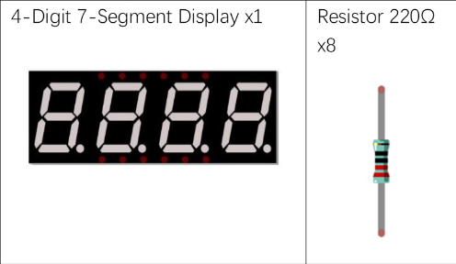
Materials Needed
For this lesson, we’ll need the following materials:
Raspberry Pi with SSH and VNC connection
Breadboard
GPIO extension board and wire
8 x 220 Ohm resistor
Button
Switch
4 Digit 7 Segment
Jumper wires

Slide 4
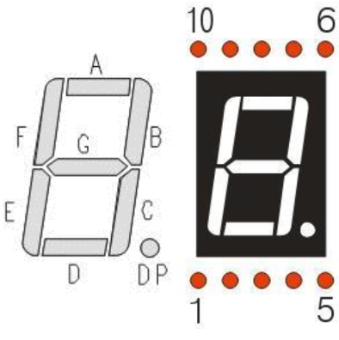
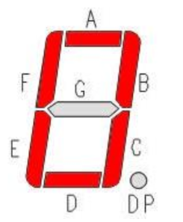

7-Segment Review
In a 7-Segment, 7 LEDs are arranged in a shape that can be selectively lit to create any number. With a decimal point, there are 8 LEDs in total.
Each LED has a common Anode and individual Cathodes.

Slide 5
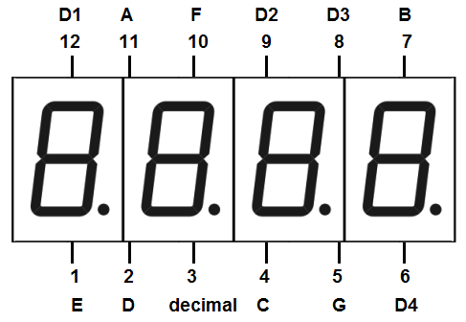
4-Digit 7-Segment
To the right is the pinout for the 4-digit 7 segment and we can see that there are the pins A-G for the individual segments and pins for D1-D4.
The D1-D4 pins are to control which segment is turned on and we can control the display by turning on a display and then outputting the proper value for A-G.
If we turn on only one display at a time, how can we view each at once?

Slide 6
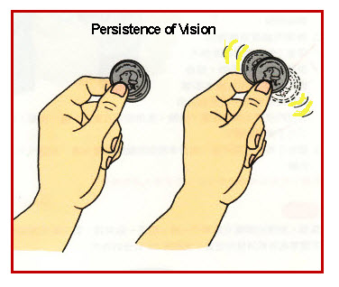
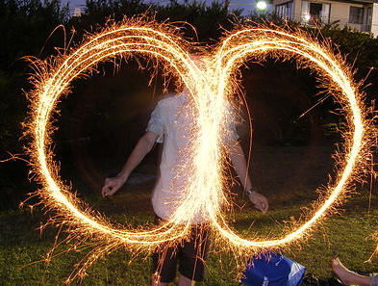
Persistence of Vision
Have you ever moved your hand quickly and created a smear effect where you saw your hand at different points.
This illusion is persistence of vision and there is period after we see light where it remains in our vision before it disappears.
We will use this property to quickly turn on and off the displays so that they will register in our vision and each display will appear to be on at the same time.
If we change the displays at too slow of a speed, the illusion will fail, and we will see flickering.

Slide 7
4-Digit 7-Segment
We will use a frequency of at least 200Hz when we turn all the displays on and off so that we can achieve the illusion that all of them are on. So, we will need to turn on each segment and output the digit all within 5ms.
We can slow down our code so that we can view each segment turn on by themselves.
The display is common anode, and we will use the same approach to setting the values of A-G as we did for the one digit 7-segment.

Slide 8
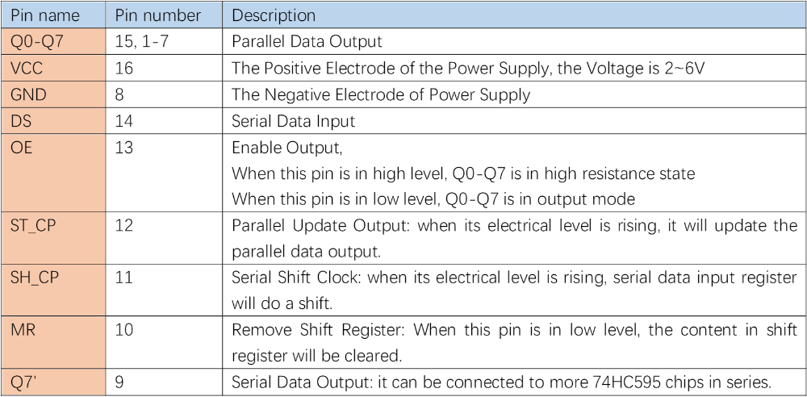
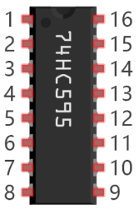
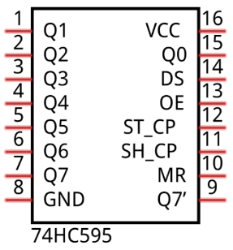
Integrated Circuit (IC) Review
The 74HC595 is an integrated circuit used to store data sent from a serial input and output it as parallel data. The register can perform shift operations and store 1 byte of data. Using this chip, we can output data from the Pi and only need to use 3 pins rather than 8.

Slide 9
Project
For our project, we are going to create a circuit that will output the current time to the display.
For the clock, the first two digits will be the hour (24-hour) and the other two digits will be the minute.
Please open the template file which contains code from the level 2’s class.
We will first test the display and then program it to display the time.

Slide 10
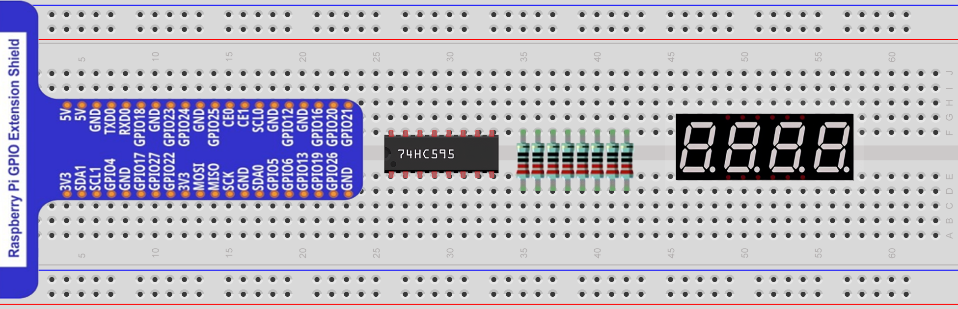
Circuit for this Project
This project’s wiring is very difficult so we will first look at the circuit without the connection wires.

Slide 11
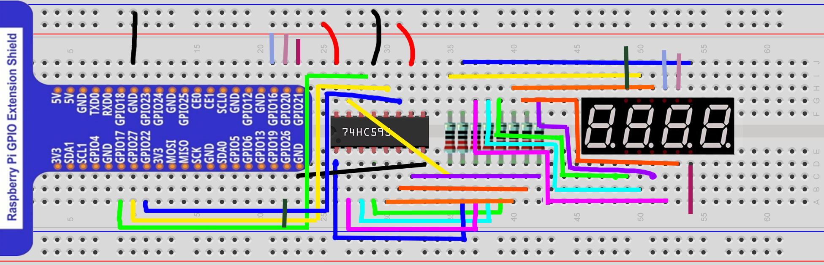
Circuit for this Project
We will now add the wires, please note that the wires leaving GPIO 26, 16, 20, and 21 do not show the full connection. They only show their endpoints with a small portion of the wire. This is done to simplify the diagram and make the connections more visible. Please ask any questions if you are unsure where a wire goes.

Slide 12
Written Description
GPIO 17 - Register 14
GPIO 27 - Register 12
GPIO 22 - Register 11
GPIO 26 - D1
GPIO 16 - D2
GPIO 20 - D3
GPIO 26 - D4
Register 16 - 3.3V
Register 14 - GPIO 17
Register 13 - GND
Register 10 - 3.3V
Register 9 - Unconnected
Register 8 - GND
Q0 (Reg 15) - A Resistor - A
Q1 (Reg 1) - B Resistor - B
Q2 (Reg 2) - C Resistor - C
Q3 (Reg 3) - D Resistor - D
Q4 (Reg 4) - E Resistor - E
Q5 (Reg 5) - F Resistor - F
Q6 (Reg 6) - G Resistor - G
Q7 (Reg 7) - DP Resistor - DP

Slide 13
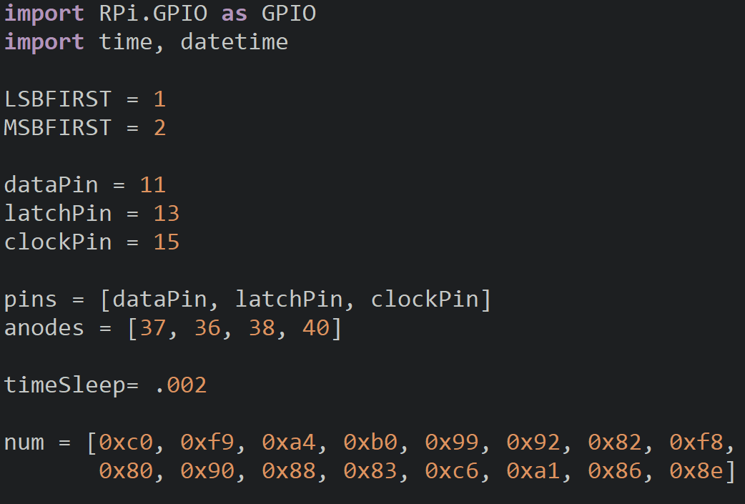
Clock Display Setup
Import the modules for the project, datetime will get the system time.
Create a list containg the pin numbers for the anodes oragnzied as [D1, D2, D3, D4].
The timeSleep variable controls how long we display the digits and turn them off.
.002 (2ms) will be perfect since we display the LEDs for 2ms and turn them off for 2ms so our total delay will be roughly 4ms which is under 5ms.

Slide 14
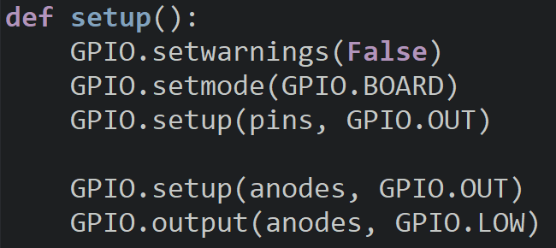
Clock Display Setup
Setup the shift register pins as outputs.
The anodes will be setup as outputs and them all off.

Slide 15
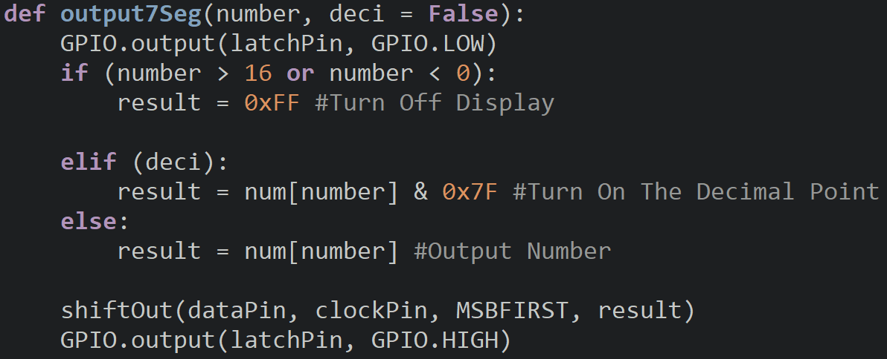
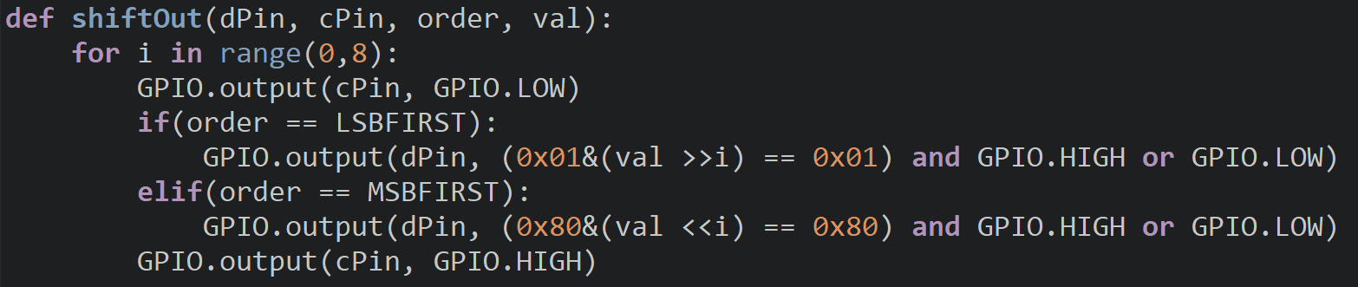
7-Segment Functions
These functions were developed in the L2 7-Seg project and will be used again to handle the segments of each display.

Slide 16
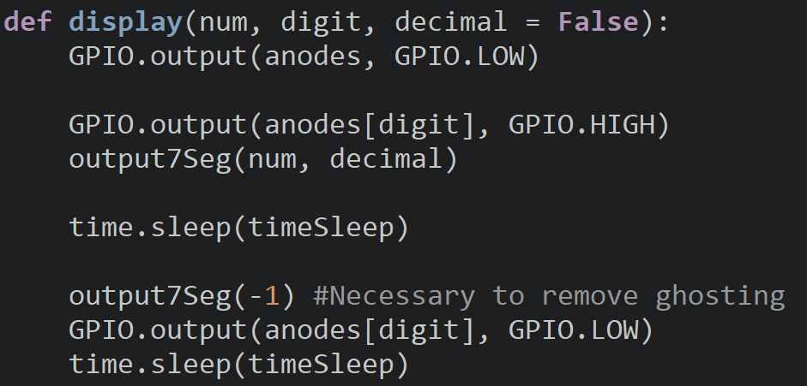
Display Function
The display function takes the number we want to output, the display to use and if to use the decimal point.
Turn off all the displays and then turn on the display we want to by accessing the pin number from the anodes list.
Call the output7Seg function and pass to it the num and decimal. We will then use a delay so the output appears on the display.

Slide 17
Display Function
output -1 to the display which clearing the segments of the display. We perform this to prevent ghosting and we will discuss this event in the next lesson.
Before the end of the function, turn off the display and sleep.

Slide 18
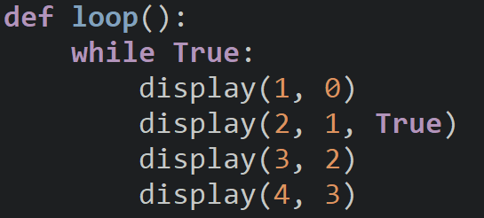
Loop
We will test out the display by displaying ‘1234’.
Call the display function four times and pass each digit to the 7-Segment.
For the 2nd digit, we turn on the decimal.

Slide 19
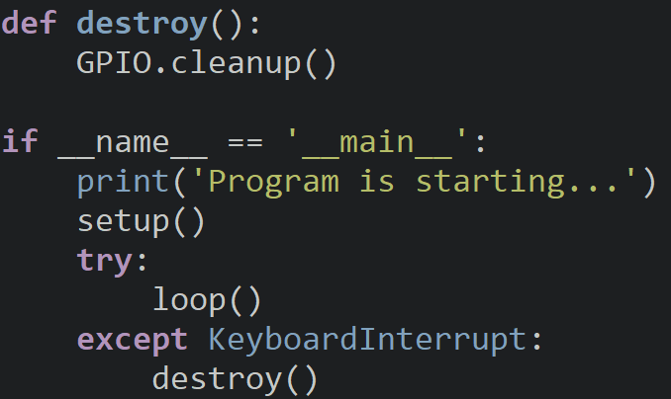
Entrance

Slide 20
Extracting the Ten’s & One’s Digits
To display the time to the 7-Segment, we must isolate each of the digits from the hour and minute to save into separate variables.
If we have a number like 12, we need to retrieve the 10’s and 1’s place so we can display the ‘1’ on one display and the ‘2’ on the other.
If we want to get the ten’s place, we will divide the number by 10 using integer division.
If we want the one’s place, we will use modulus 10 on the number.
Ten’s = 12//10 = 1 One’s = 12 %10 = 2

Slide 21
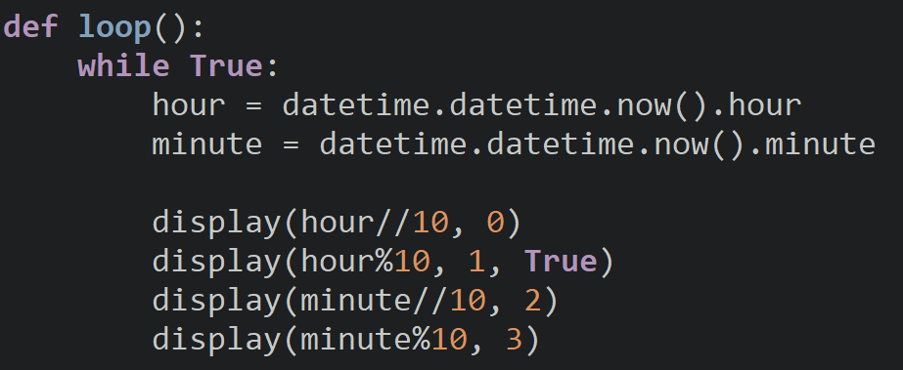
Loop
Inside of our loop, save the hour and minute into different variables, datetime is able to provide this information.
Call the display function four times and pass each digit of the time.
For the 2nd hour digit, turn on the decimal to indicate the end of the hour.

Slide 22
Try It Out
Is the time accurate to the time on the Raspberry Pi’s clock?
Does it change every minute?
How could we change the output to use minutes and seconds?

Slide 23
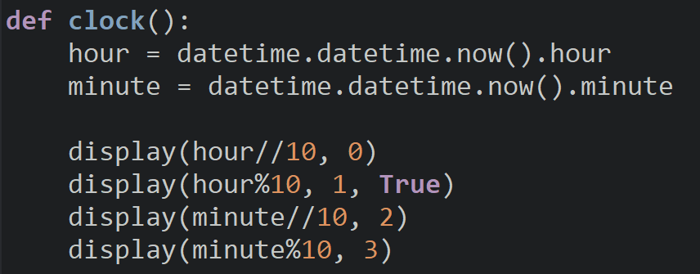
Clock Function
Before we go, move the code we created into its own function so we can add more functions and create a larger project in the future.

Slide 24
Discussion
How could we create an alarm that sounds a buzzer when a certain time is reached?
How could we modify our code to display the time in a 12-hour form?
What are some other projects that we can use the 4-digit 7-Segment for?
If we were given an 8-digit 7-Segment, would our code work for it? (assuming we added the pins for it)

Slide 25
Power off
As usual, shut down your pi properly before disconnecting power.

